Slide 1
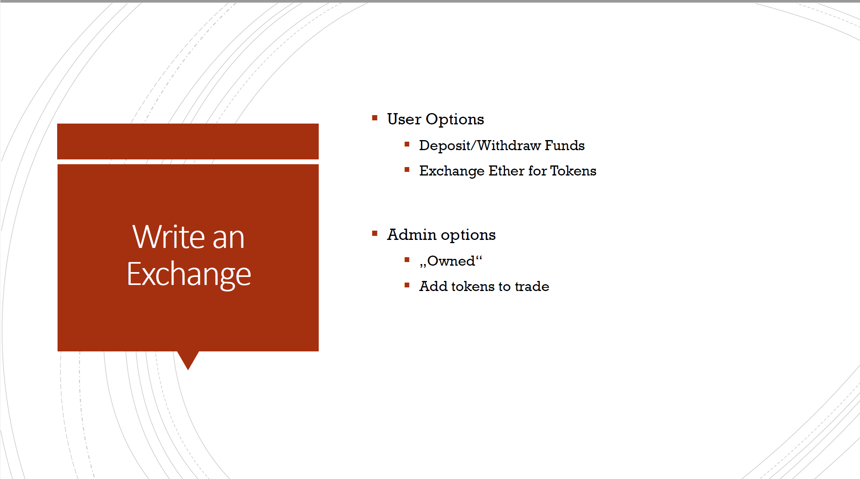

Slide 2
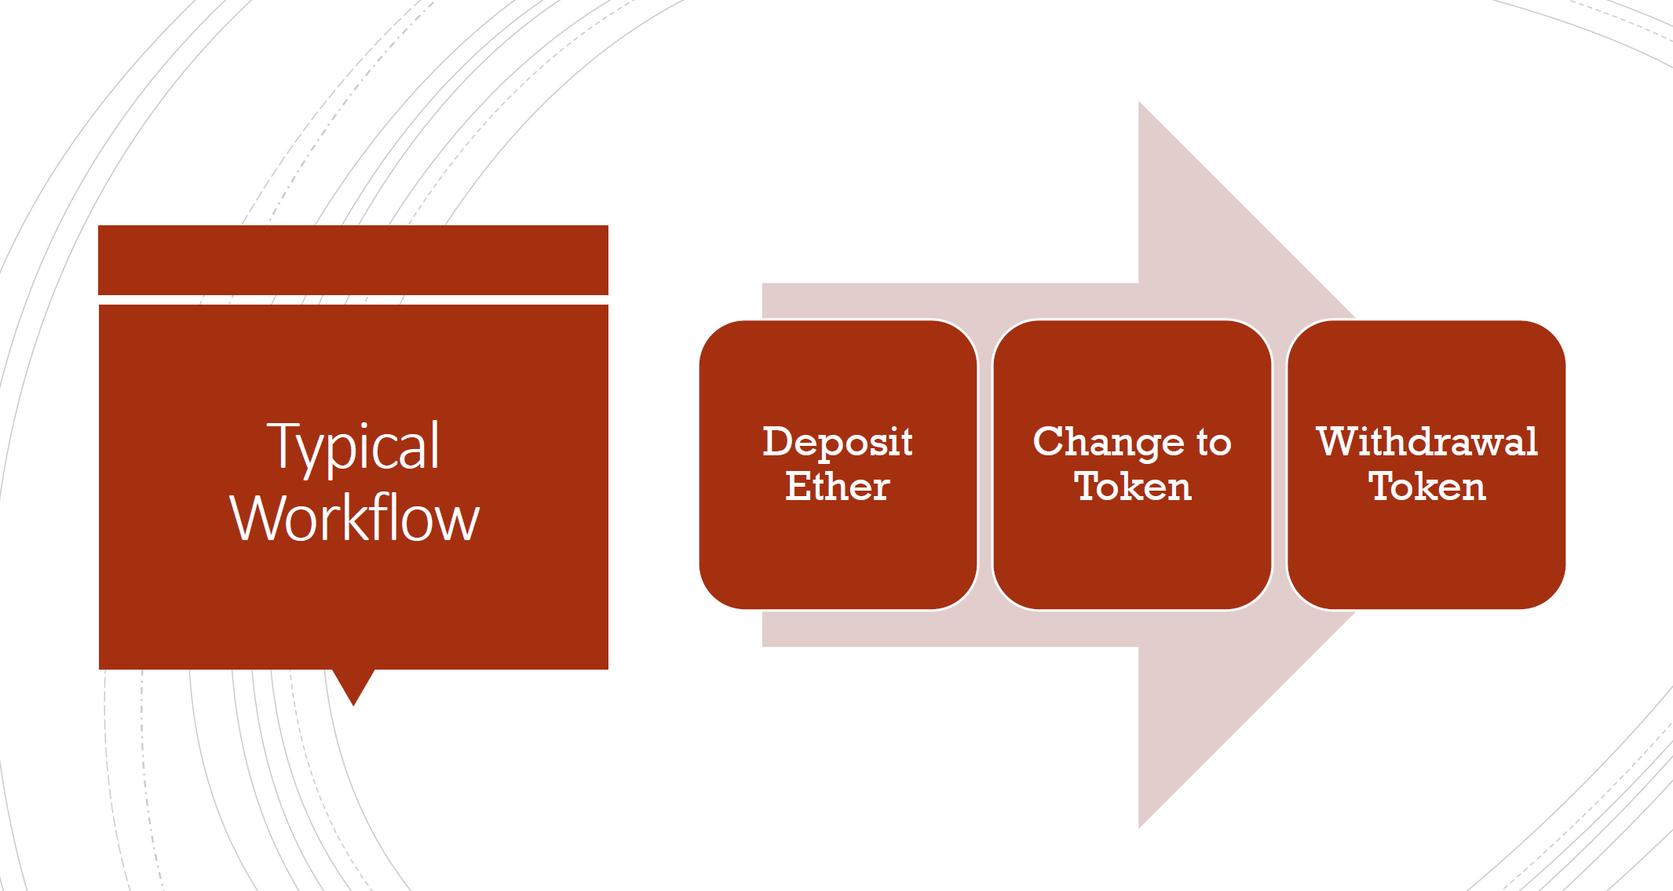

Slide 3
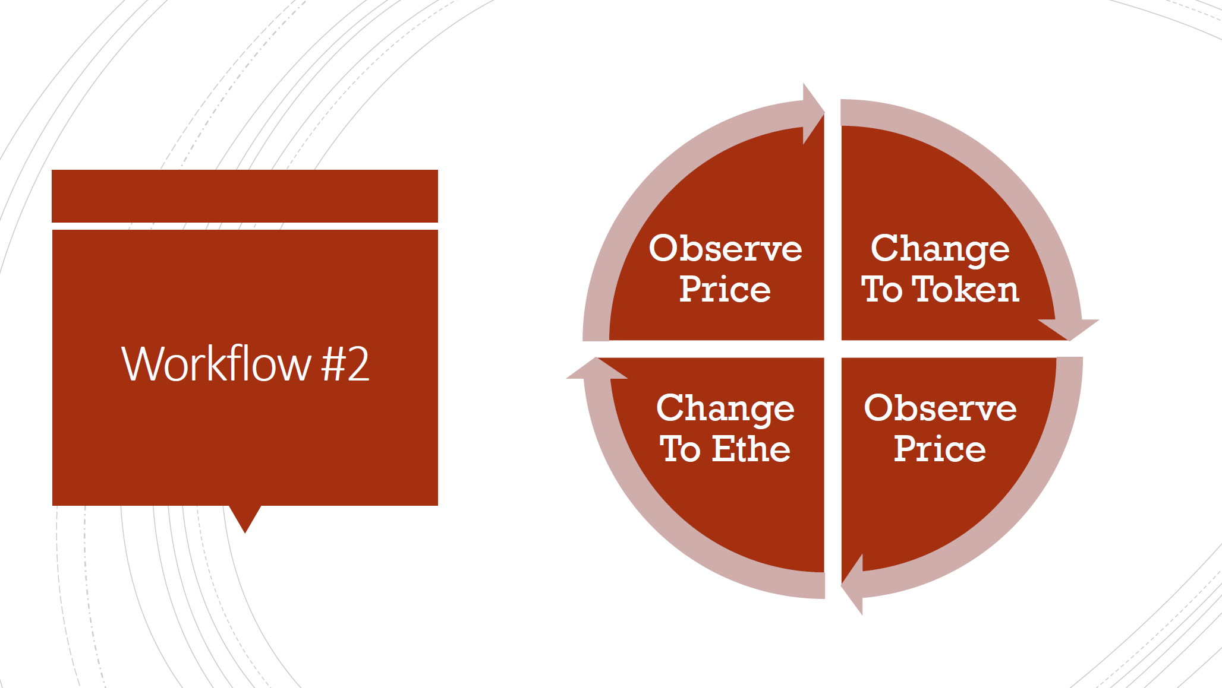

Slide 4
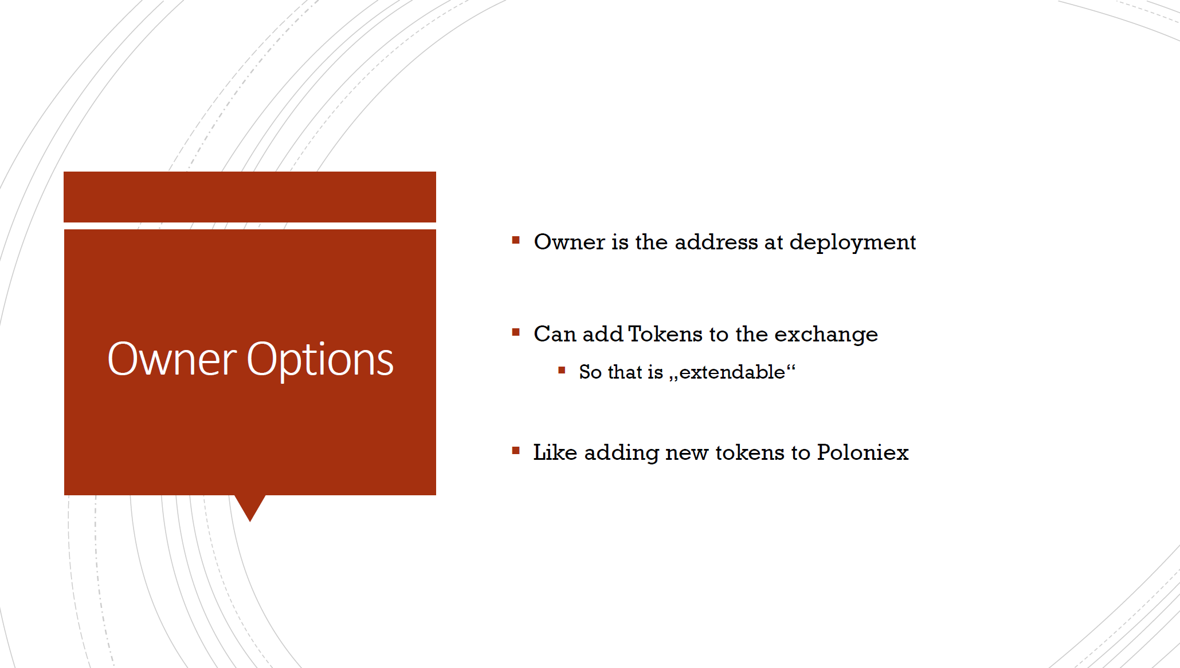
Aka. The smart contract’s address

Slide 5
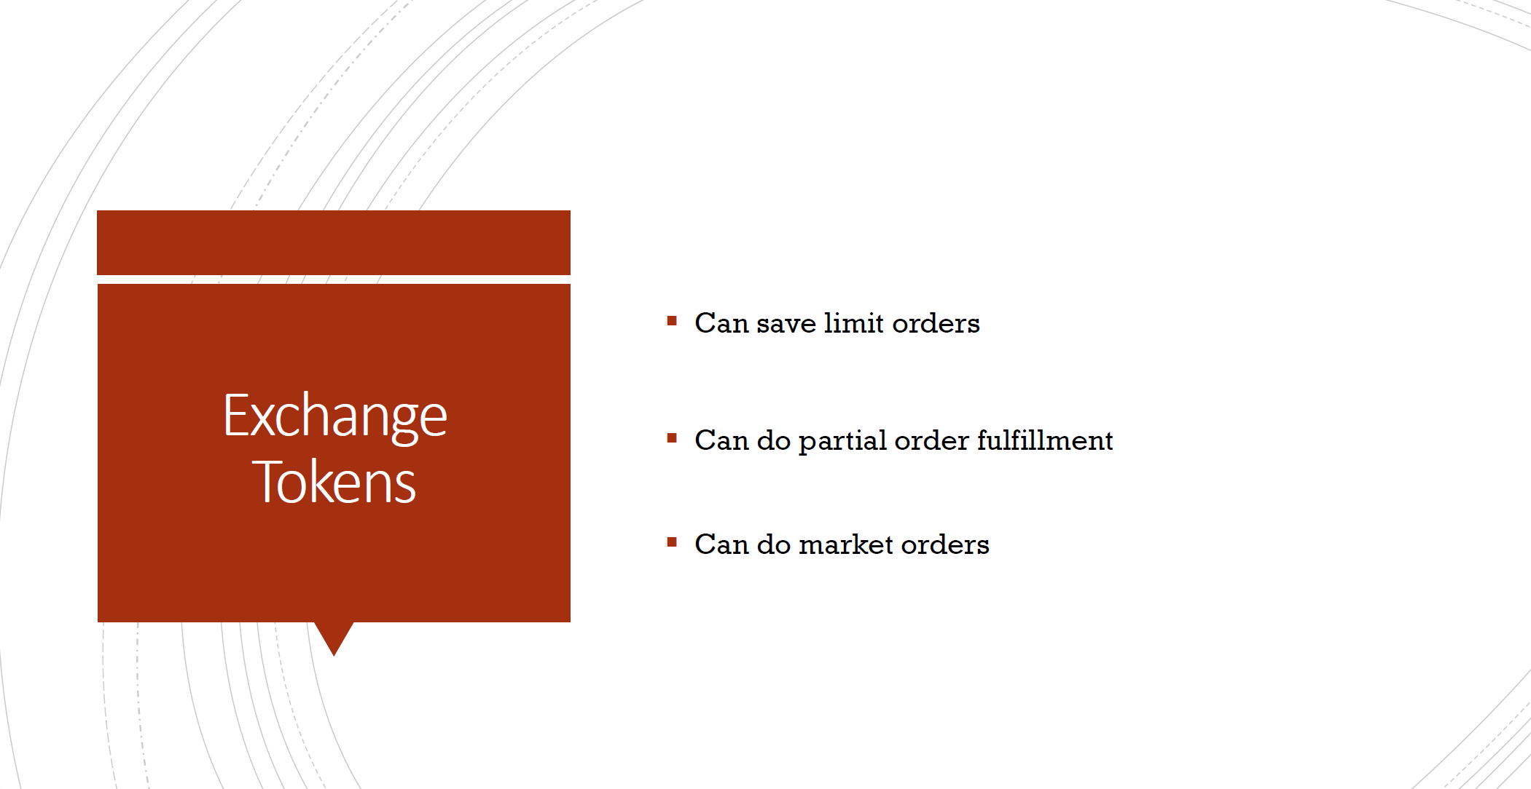
Not tested!

Slide 6
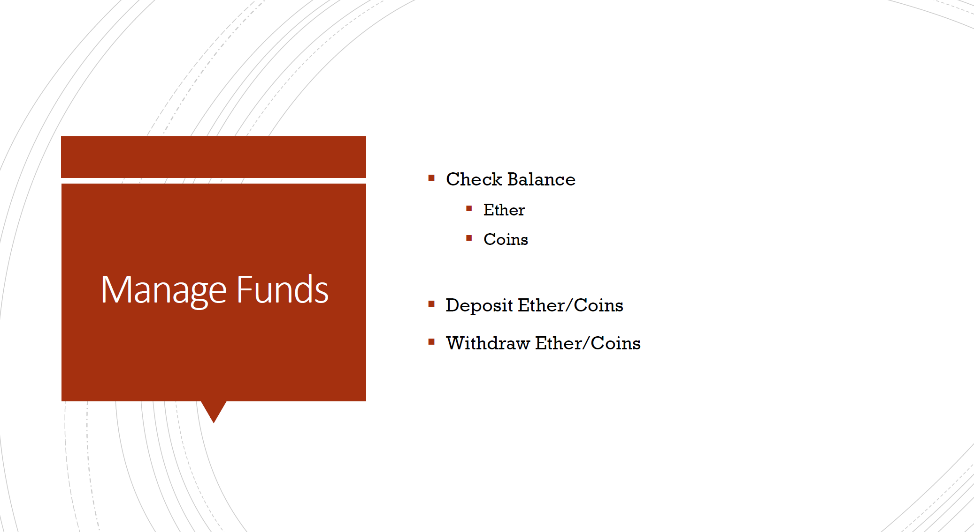
Not integrated with front end yet

Slide 7
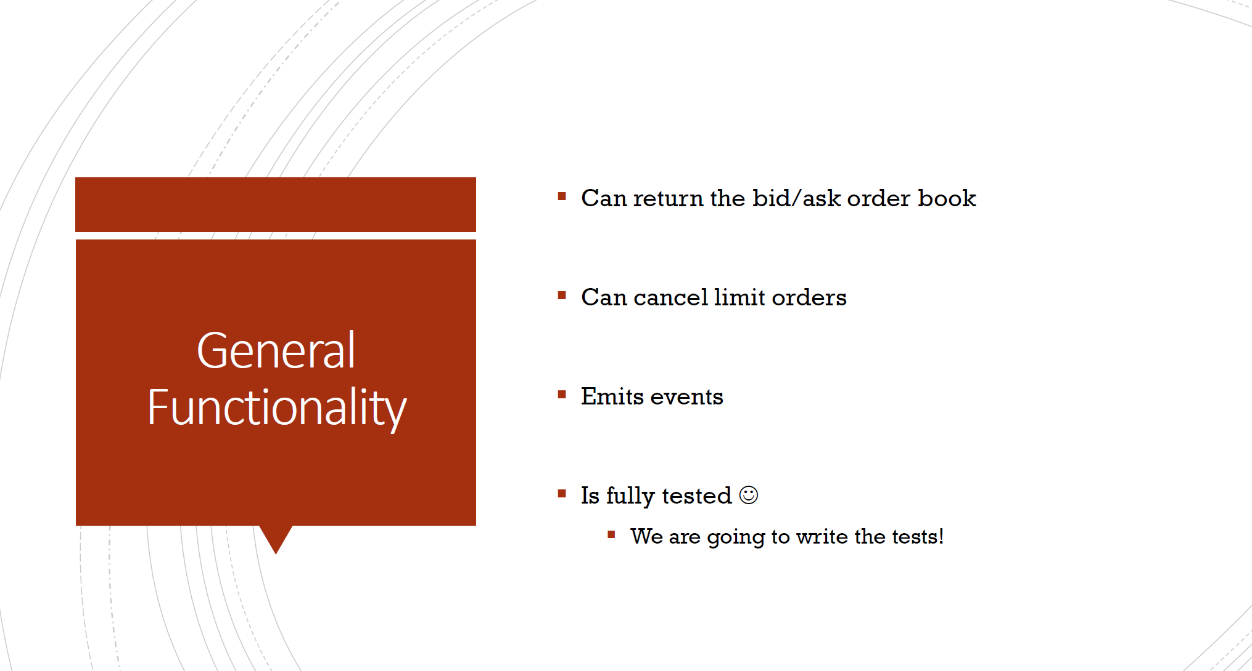
Not integrated or tested!
Not integrated or tested!

Slide 8


Slide 9
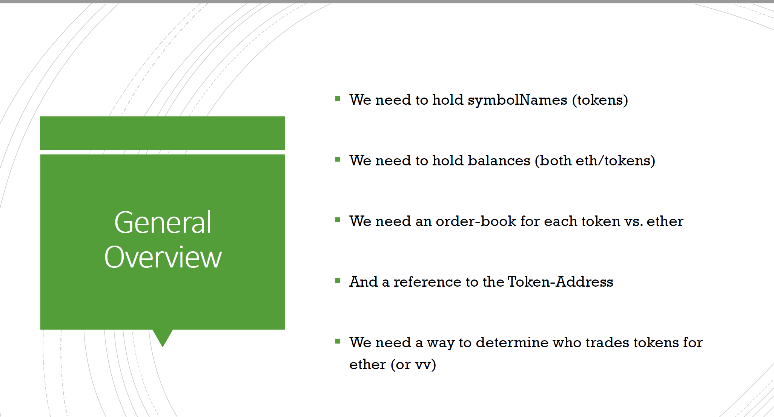

Slide 10
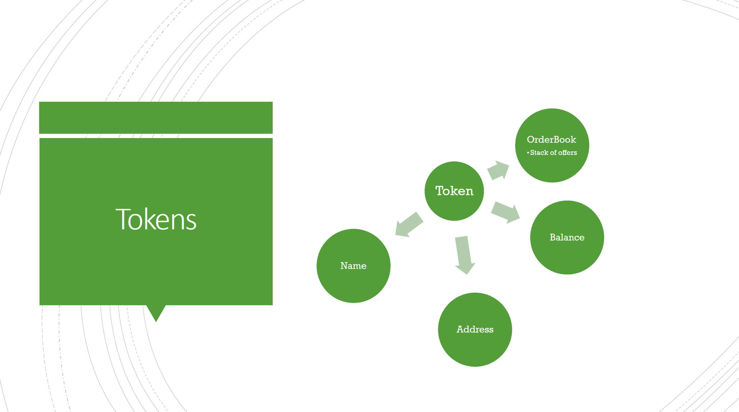

Slide 11
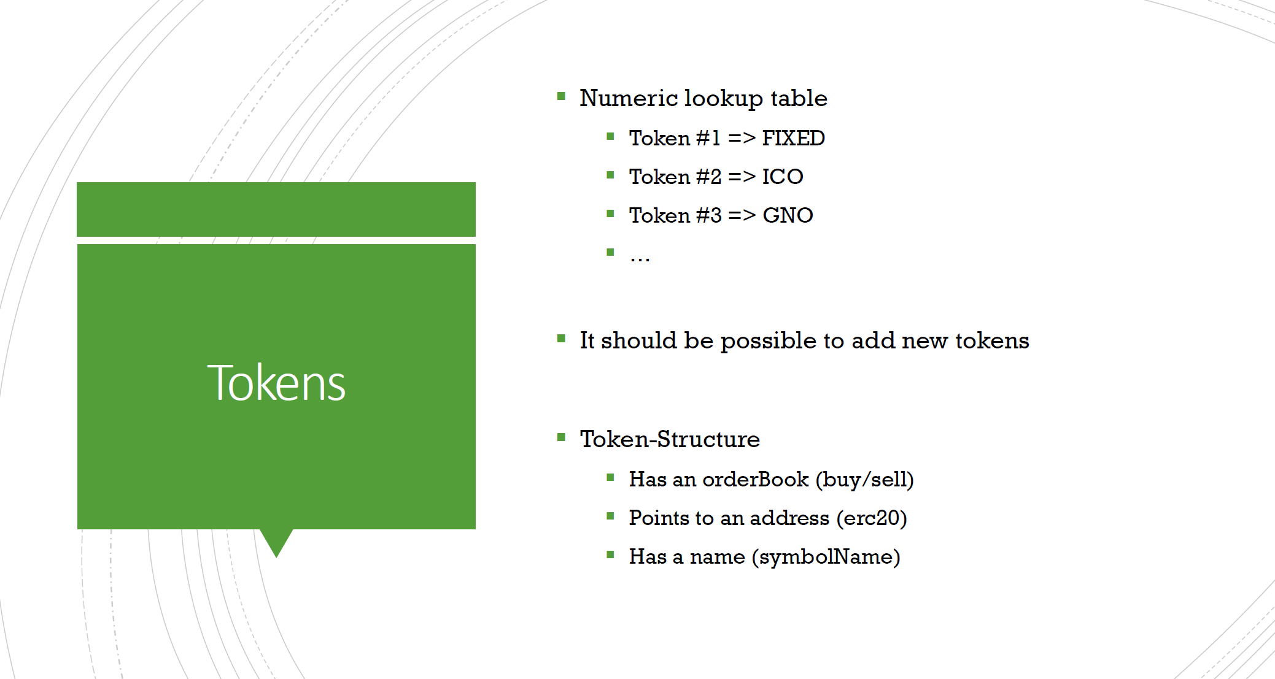

Slide 12
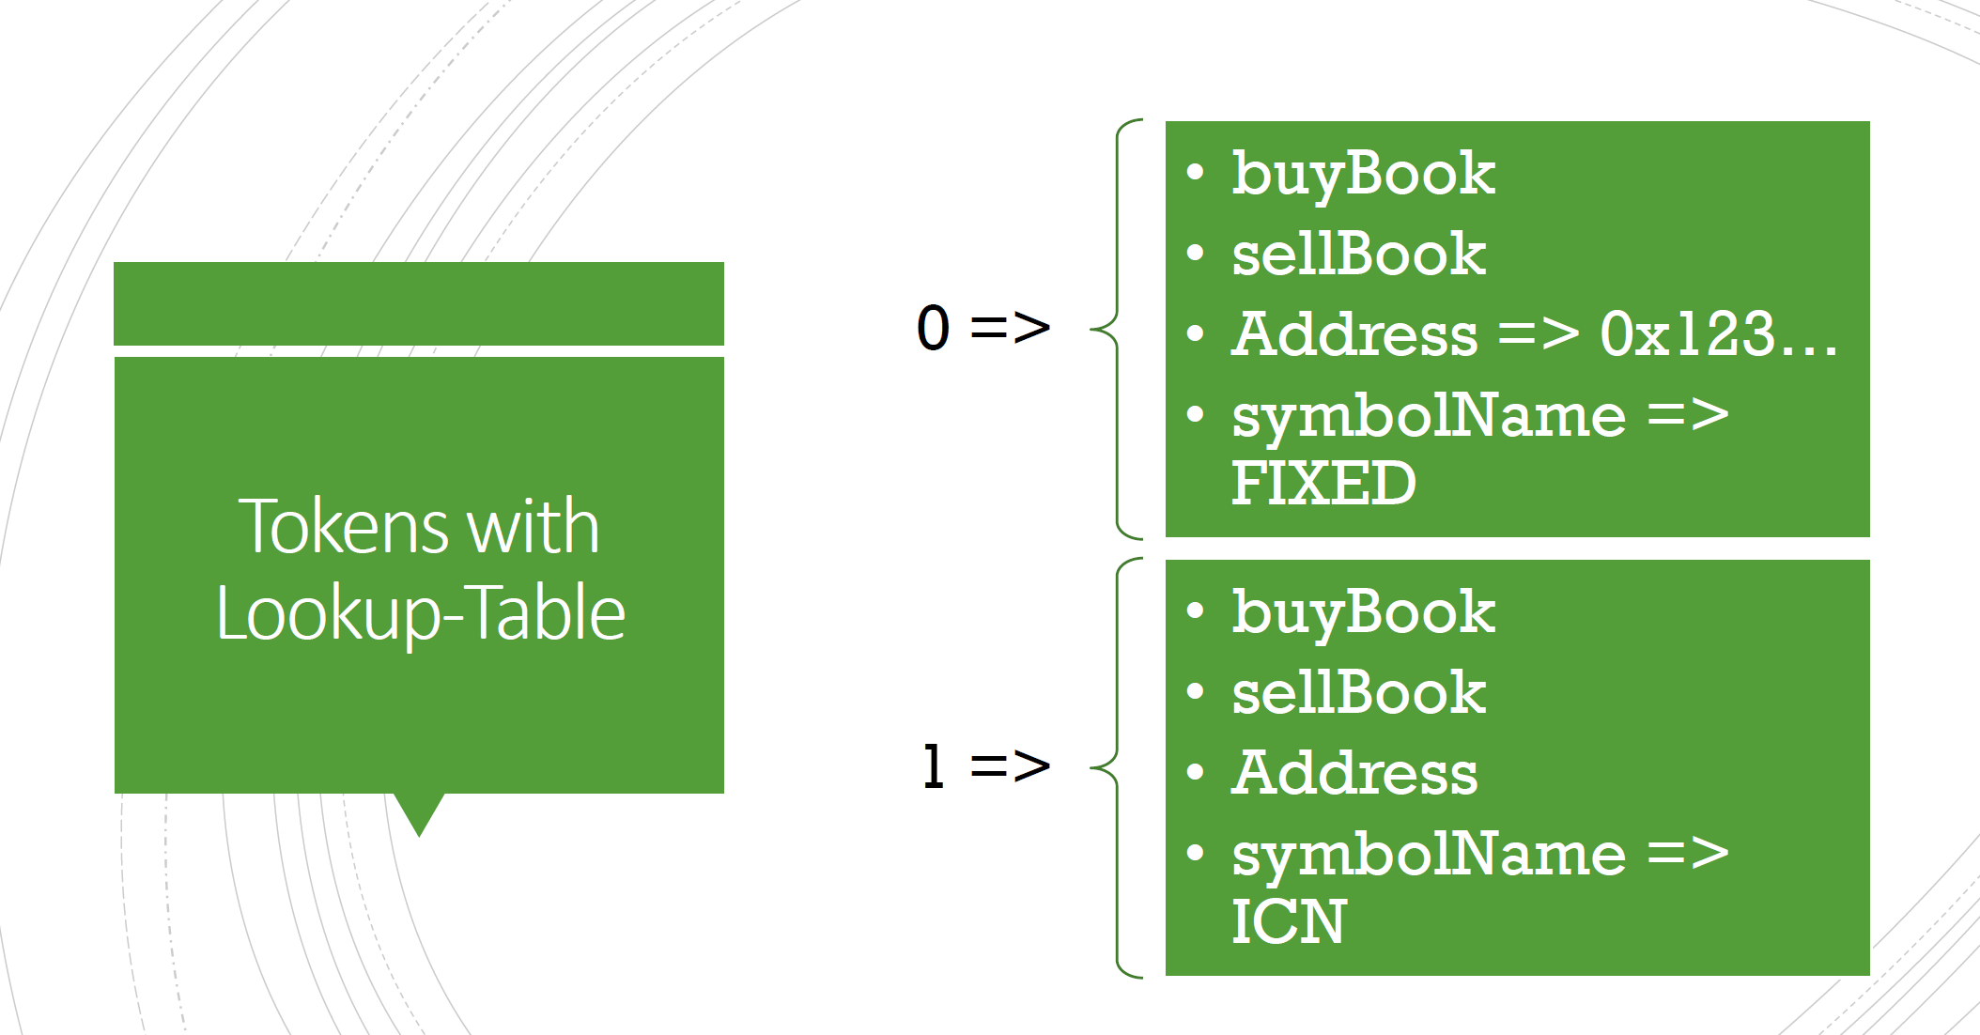

Slide 13
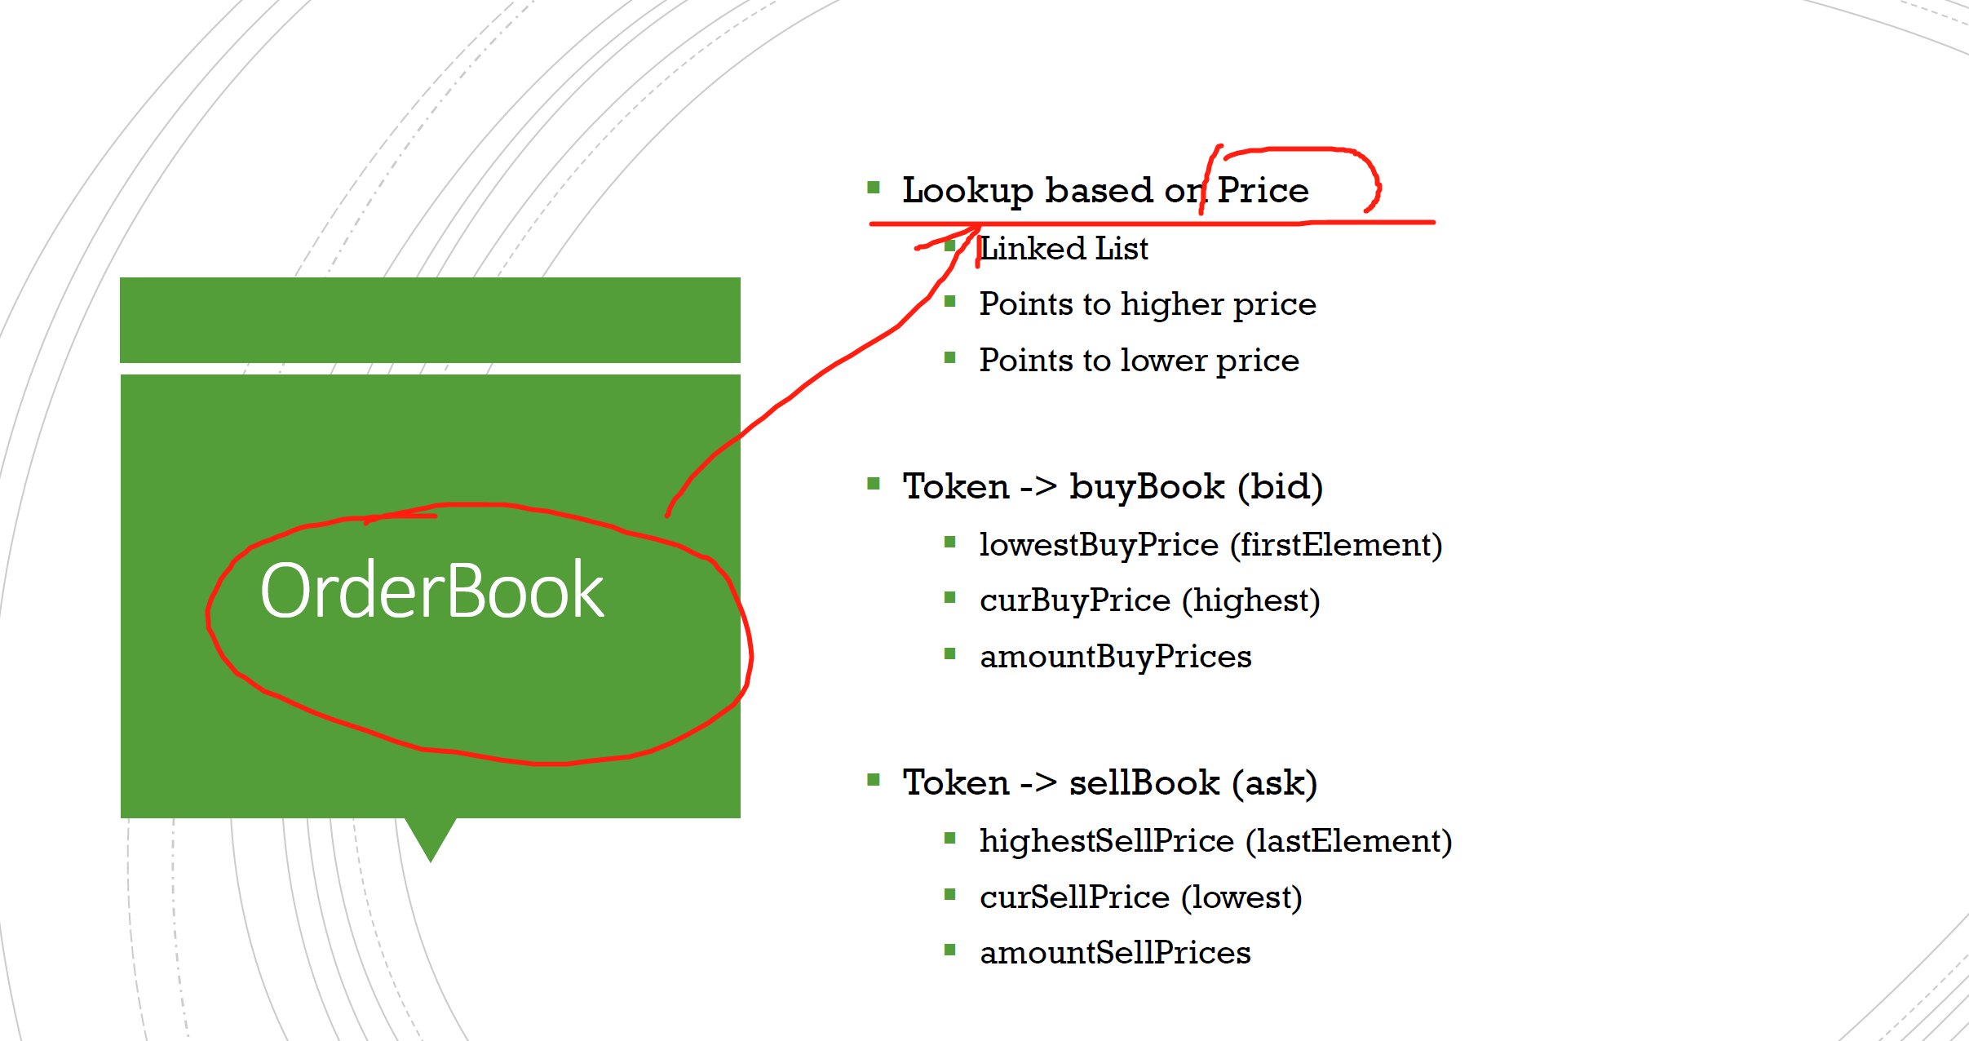

Slide 14
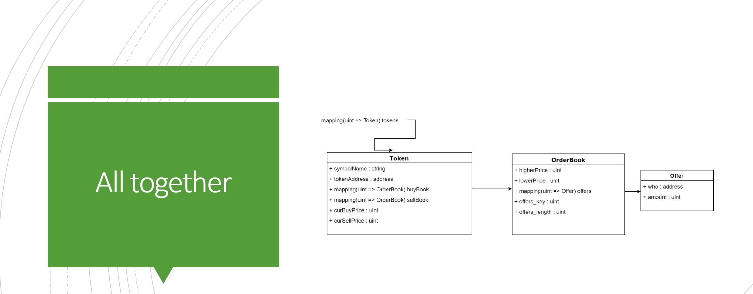

Slide 15
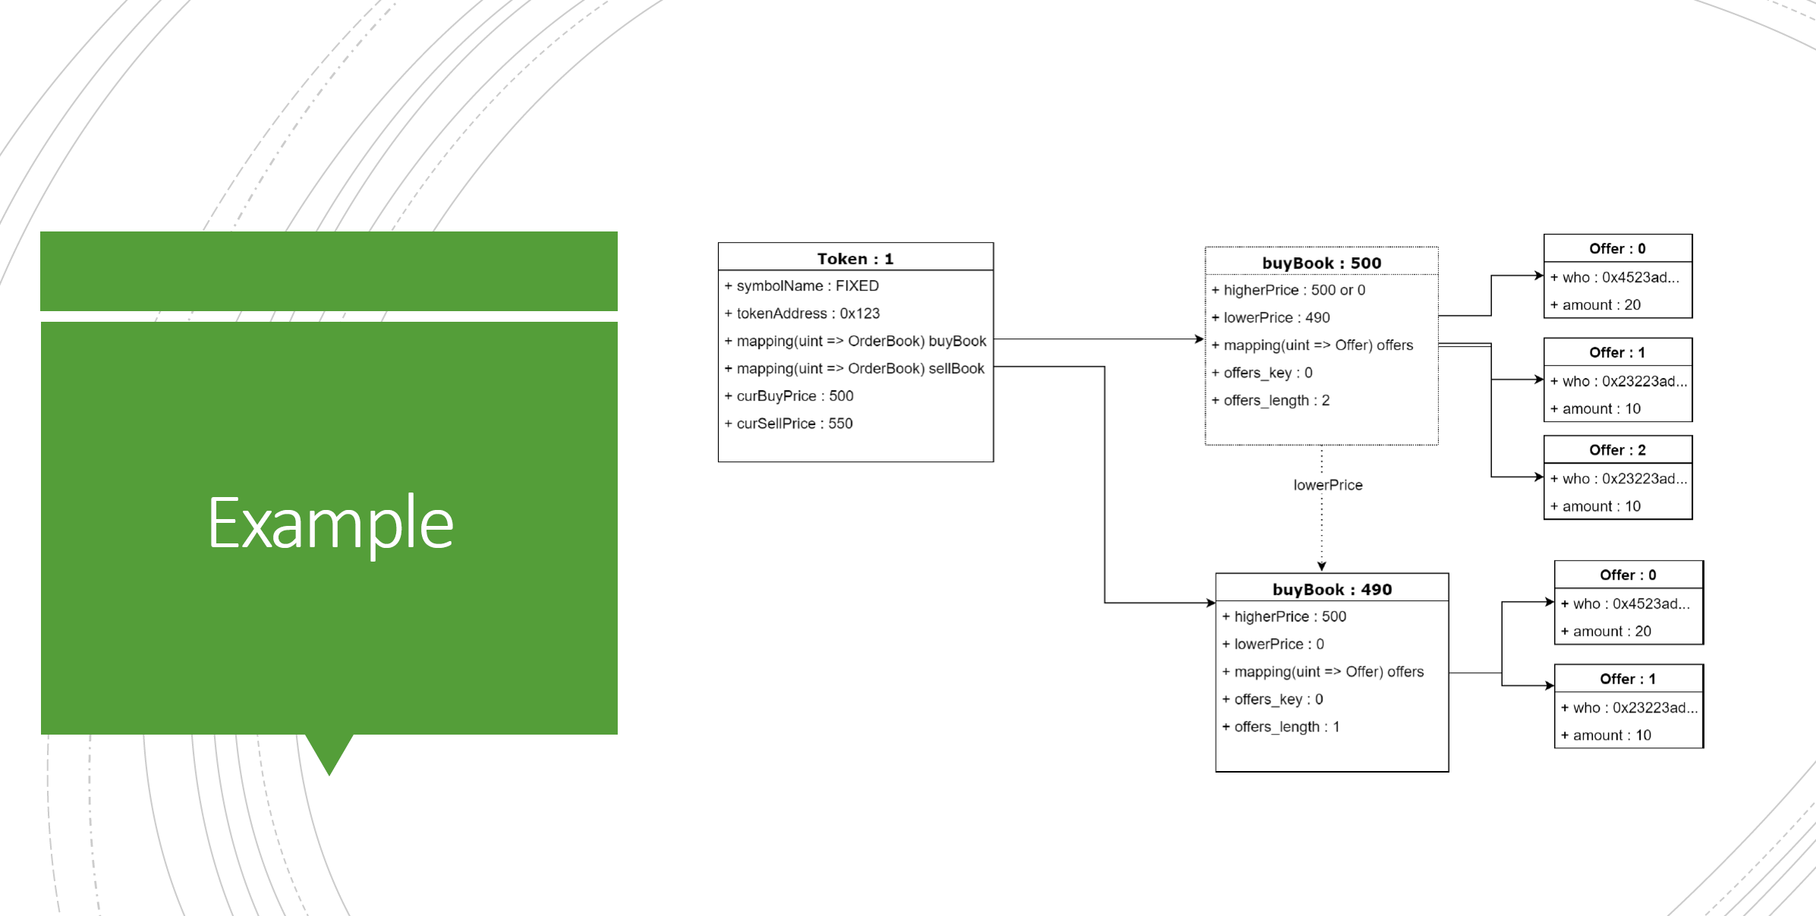

Slide 16
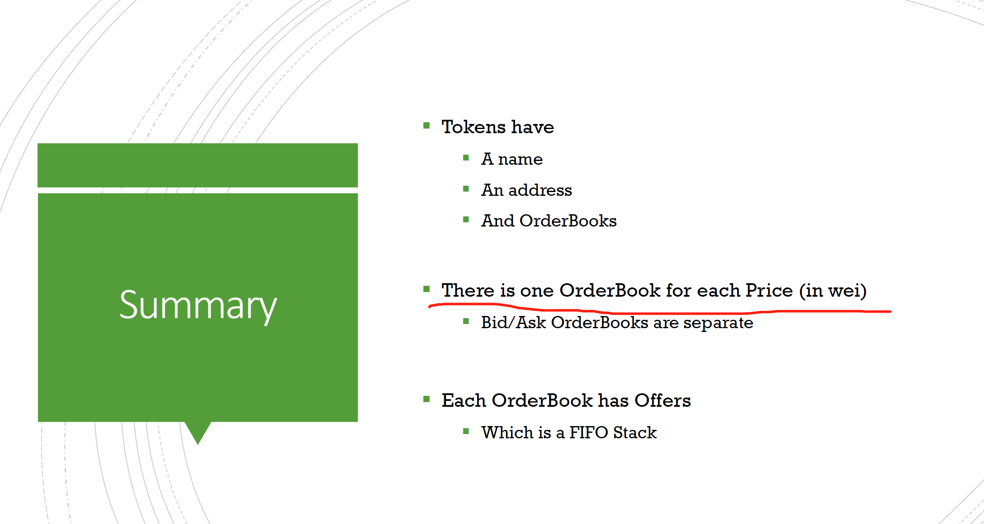

Slide 17
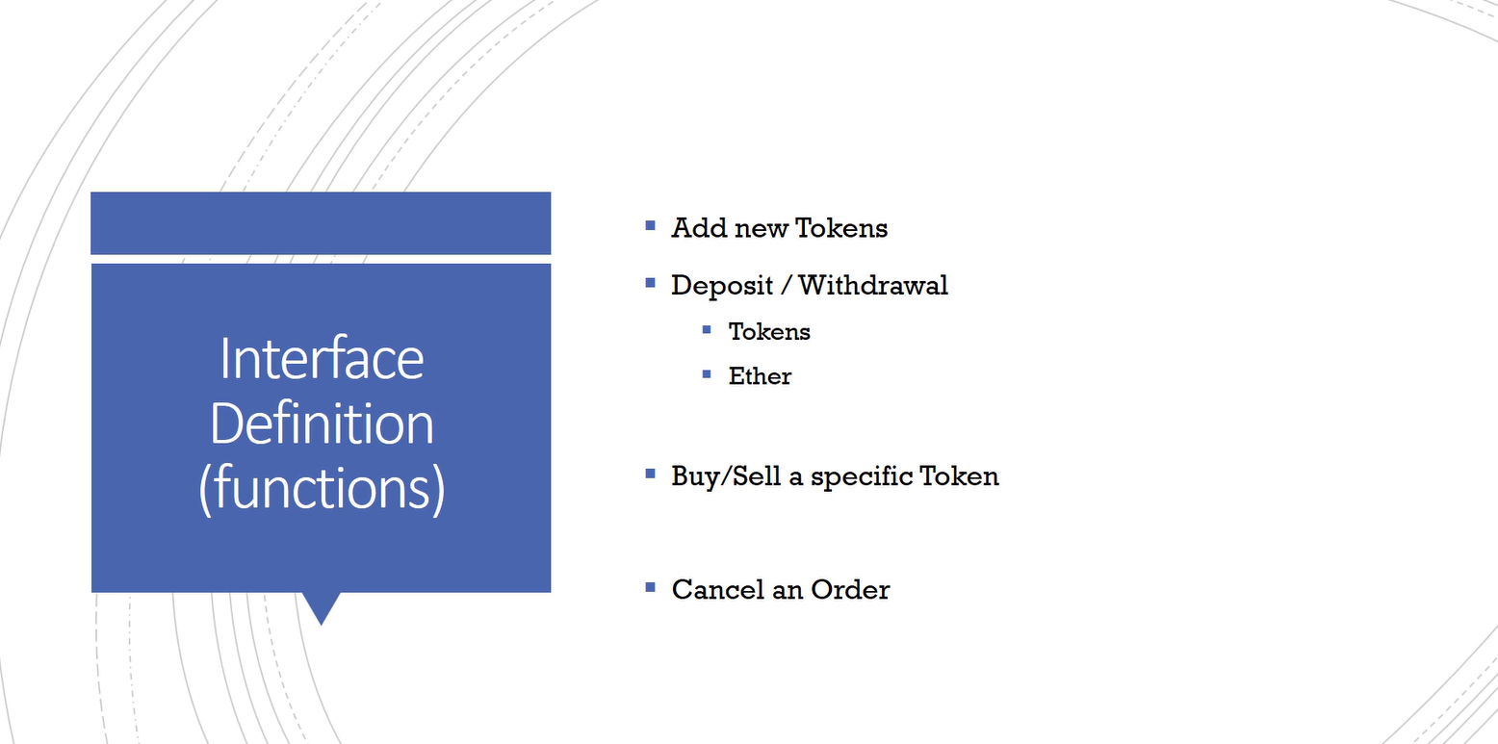

Slide 18
WHAT IS MSG.SENDER AND ADDRESS(this)
msg.sender is a pre-defined global variable in Solidity, which represents the address of the account or smart contract that called the current function. It is an important variable for implementing access control and authorization mechanisms in smart contracts.
address(this) is a way to refer to the address of the current smart contract instance. It can be used to retrieve information about the smart contract itself or to perform actions such as sending or receiving funds.
In summary, msg.sender refers to the address that initiated the current function call, while address(this) refers to the address of the current smart contract instance.

Slide 19
